Slide 1
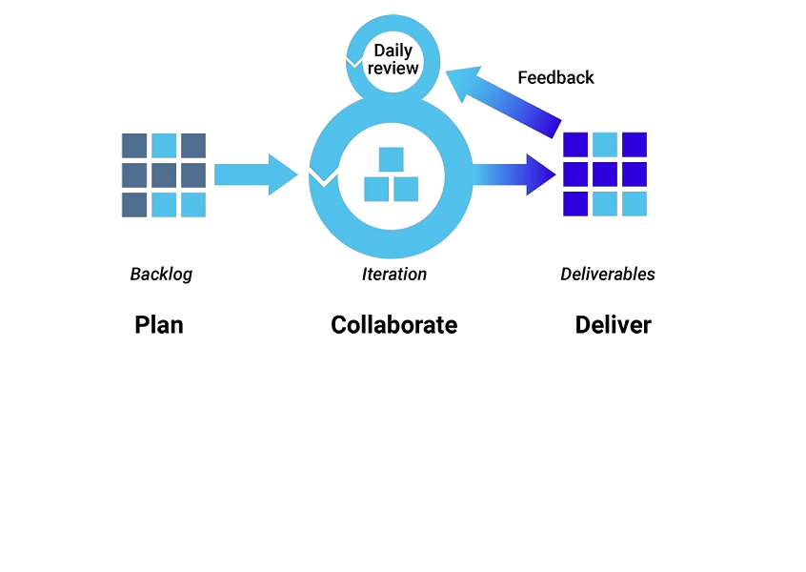
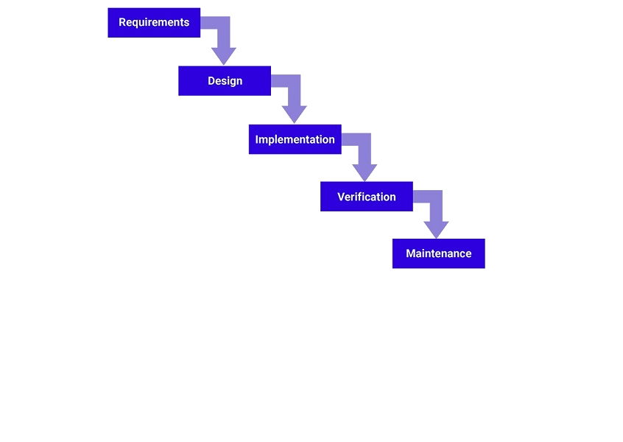
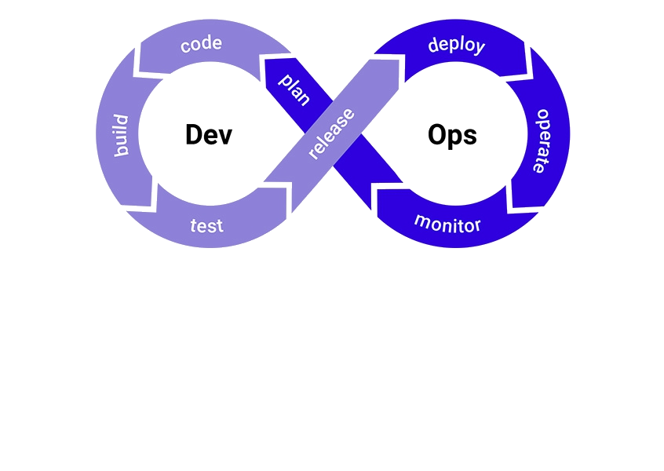
Development Methodology
When choosing a development methodology, it was clear that the methodology had to best represent the development team and also how to best achieve the requirements we have set out, while also working within the restrictions that will be most likely faced. To come to our decision, we focused on the main development methodologies and compared their strengths to our requirements
Waterfall – Very rigid, gives strong and clear organization to the group with a complete timeline of each step of development. However, limited in its efficiency to develop features quickly, and is not very dynamic to changing requirements and restraints
Agile – Teamwork and results focused framework, that allows the development cycle to be constantly checked and dynamically change to fit requirements and constraints. It is also organized into specific time periods of development, to make sure that development is done within a time limit.
Dev-Ops – A work quality methodology and organization structure that is focused on returning a high level of development and software within an infinite development cycle, that is able to constantly improve with client and market feedback. Well focused on delivering results, however, may not fit our time schedule and due to the nature of the goal, there is a lack of changing market need after the timeline of the product is complete

Slide 2
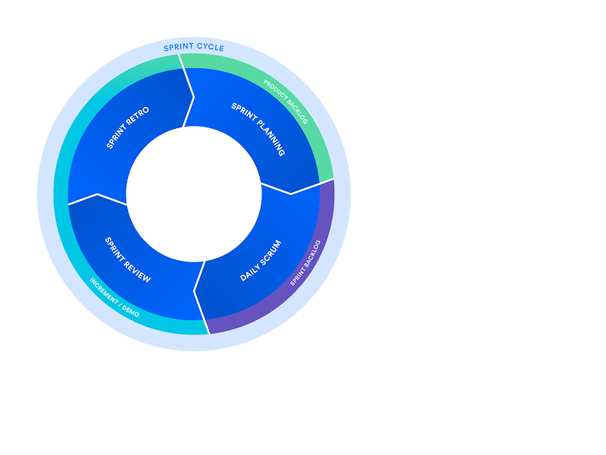

Scrum
Why the Scrum-Agile methodology is best suited to our projects needs:
1
Scrum like its Agile counterpart Extreme Programming (XP), are focused within sprints of development. Intense periods of development decreases development time.
2
Scrum, however unlike XP is focused on delivering iterations and features in the most optimal way, without the need for constantly changing client requirements, while also being dynamic to restrictions, that are identified within both requirements documentation and identified during development
3
Scrum fits our requirements and developer composition well, as it encourages teamwork, daily checks on development, and quick organization.
Bonus: Scrum’s constant check-ups increase transparency in workflow, so that every developer can work at equal pace.

